Slide 1
Introduction
Product Design and Development
Chapter 1
Karl T. Ulrich and Steven D. Eppinger
5th Edition, Irwin McGraw-Hill, 2012.

Slide 2
Chapter Outline
Characteristics of successful product development
Who designs and develop products
Duration and cost of product development
The challenges of product development
Structured methods
Organizational Realities

Slide 3
Research and Development
R
T
D
Basic
Research
Technology
Development
Product
Development
Discovery process
No set timing
Unpredictable returns
Long term
Loosely structured
Difficult to plan
Less predictable
Medium term
Structured methods
Planned timing
Predictable outcome
Short term

Slide 4
Changing Dimensions of Competition
Manufacturing:
Cost and Quality
Product Development:
Features and Function
Competitiveness today is more than ever based on product development capability.

Slide 5
Creating Value through
Product Development:
It’s all about the product.

Slide 6
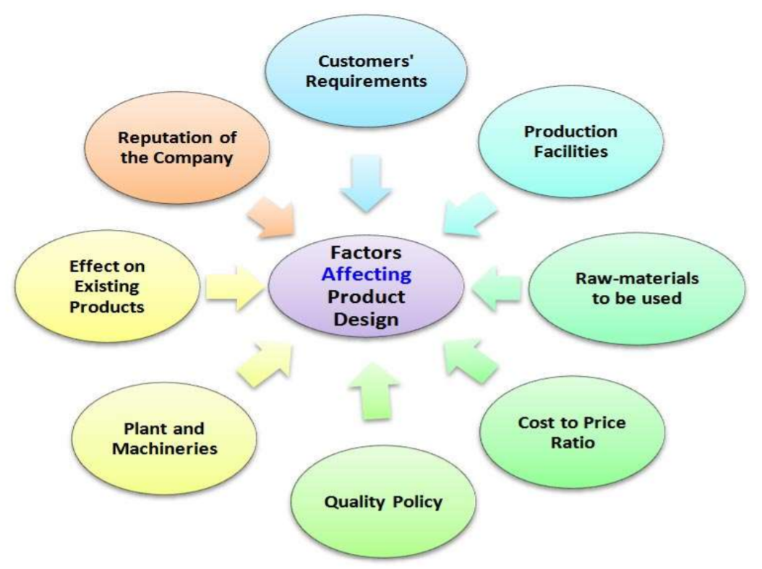


Slide 7
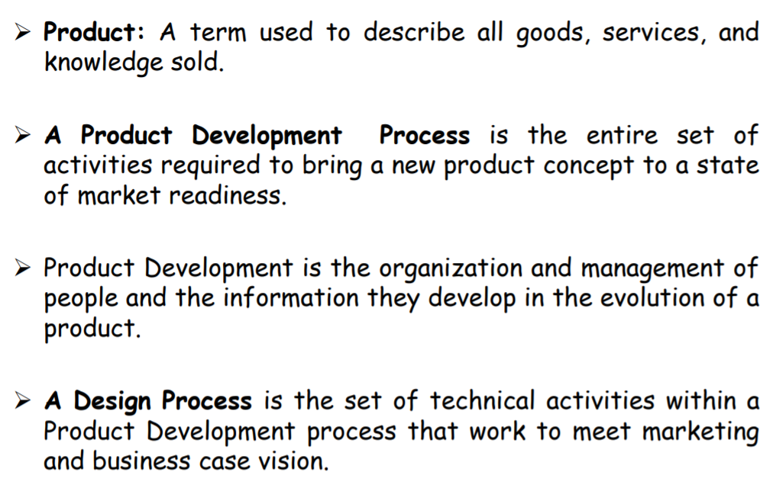

Slide 8
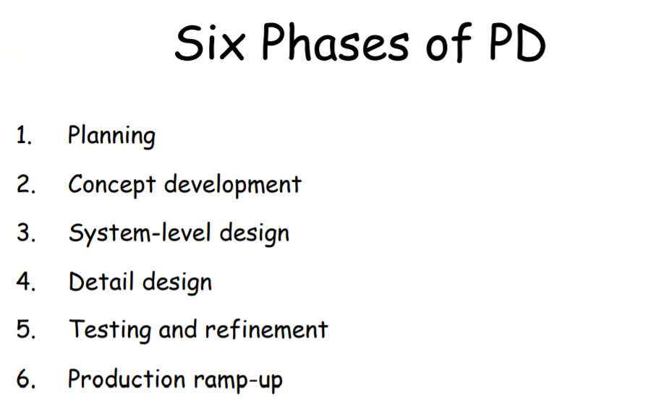

Slide 9
Product Types
Market-Pull Products (furniture, sporting goods, tools)
Technology-Push Products (Cellular phones, Medical equipment)

Slide 10
The Life-cycle of a Product
Identification of need
Development of engineering requirements
Design concept development
Product design
Manufacturing
Assembly
Distribution
Installation
Use
Retirement, disassembly, reuse, and recycle.

Slide 11
Product Conceptual Design
Design = Art + Science
Product Design = Form + Function

Slide 13



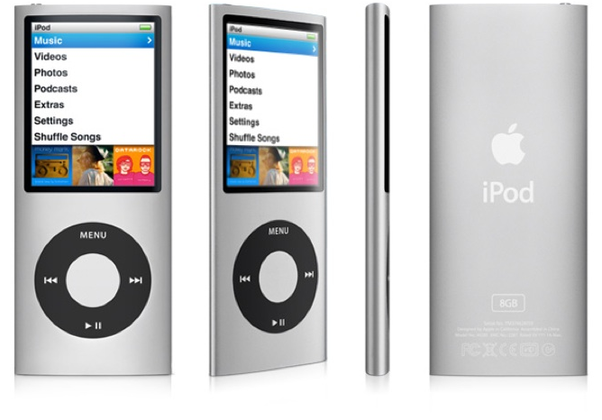

Apple: Simply Better Products

Slide 14


Black & Decker Snake Light

Slide 15

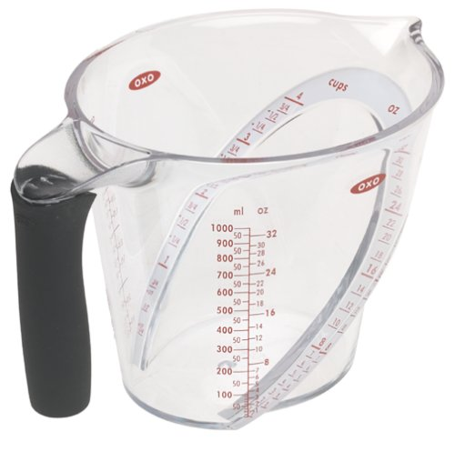
GoodGrips Angled Measuring Cups

Slide 16

Target Prescription Pill Bottle

Slide 17


Bodum Pavina Glasses

Slide 18
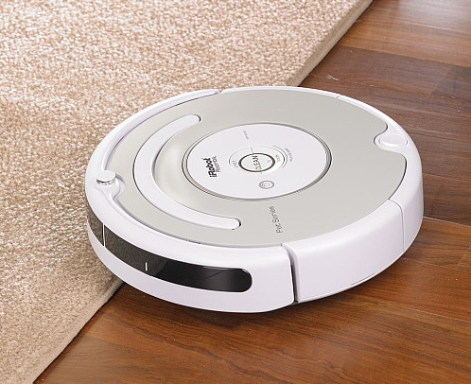
iRobot Roomba

Slide 19
Back to the History
Corporate stories of success and failure:
  Nokia digital mobile phones
  Ford Sport/utility vehicles
  George Foremen grill
  Apple computer: iPod, iPad, i…
  Digital cameras
  Thermo care

Slide 20
Lessons learned from the stories
It is products like these that make companies successful
  and competitors retreat.
What in common is that their developers understood their customers and their competitors
They created products that met or exceeded their customers’ expectation
With these products, these companies became competitive at that time.

Slide 21
Characteristics of successful product development
Product quality (features and value)
Development lead time
Product cost
Development cost
Accumulation of development capability and experience of the team.

Slide 22
Today’s business environment
  Innovation
    Be the first in the market
  Shortened product life cycle & shortened product development cycle
    concurrent engineering/operation
  Frequent changes & agile operations
    mass customization
  Smaller lots and just-in-time production
    lean manufacturing/thinking
  Core business and supply network
  Global economy and corporate intelligence
  Internet and wireless integration

Slide 23
Scope of development efforts
The team
  Development time: 1-5 years
  Development cost: US$100K-3B
  Team size (internal): 3-10K
  Team size (external): 3-10K
The product
  Product cost: US$1-200M
  Numbers of parts: 3-130K
  Annual production volume: 50-50M
  Sales lifetime: 1-40 years
  Initial production cost: US$100K-3B

Slide 24
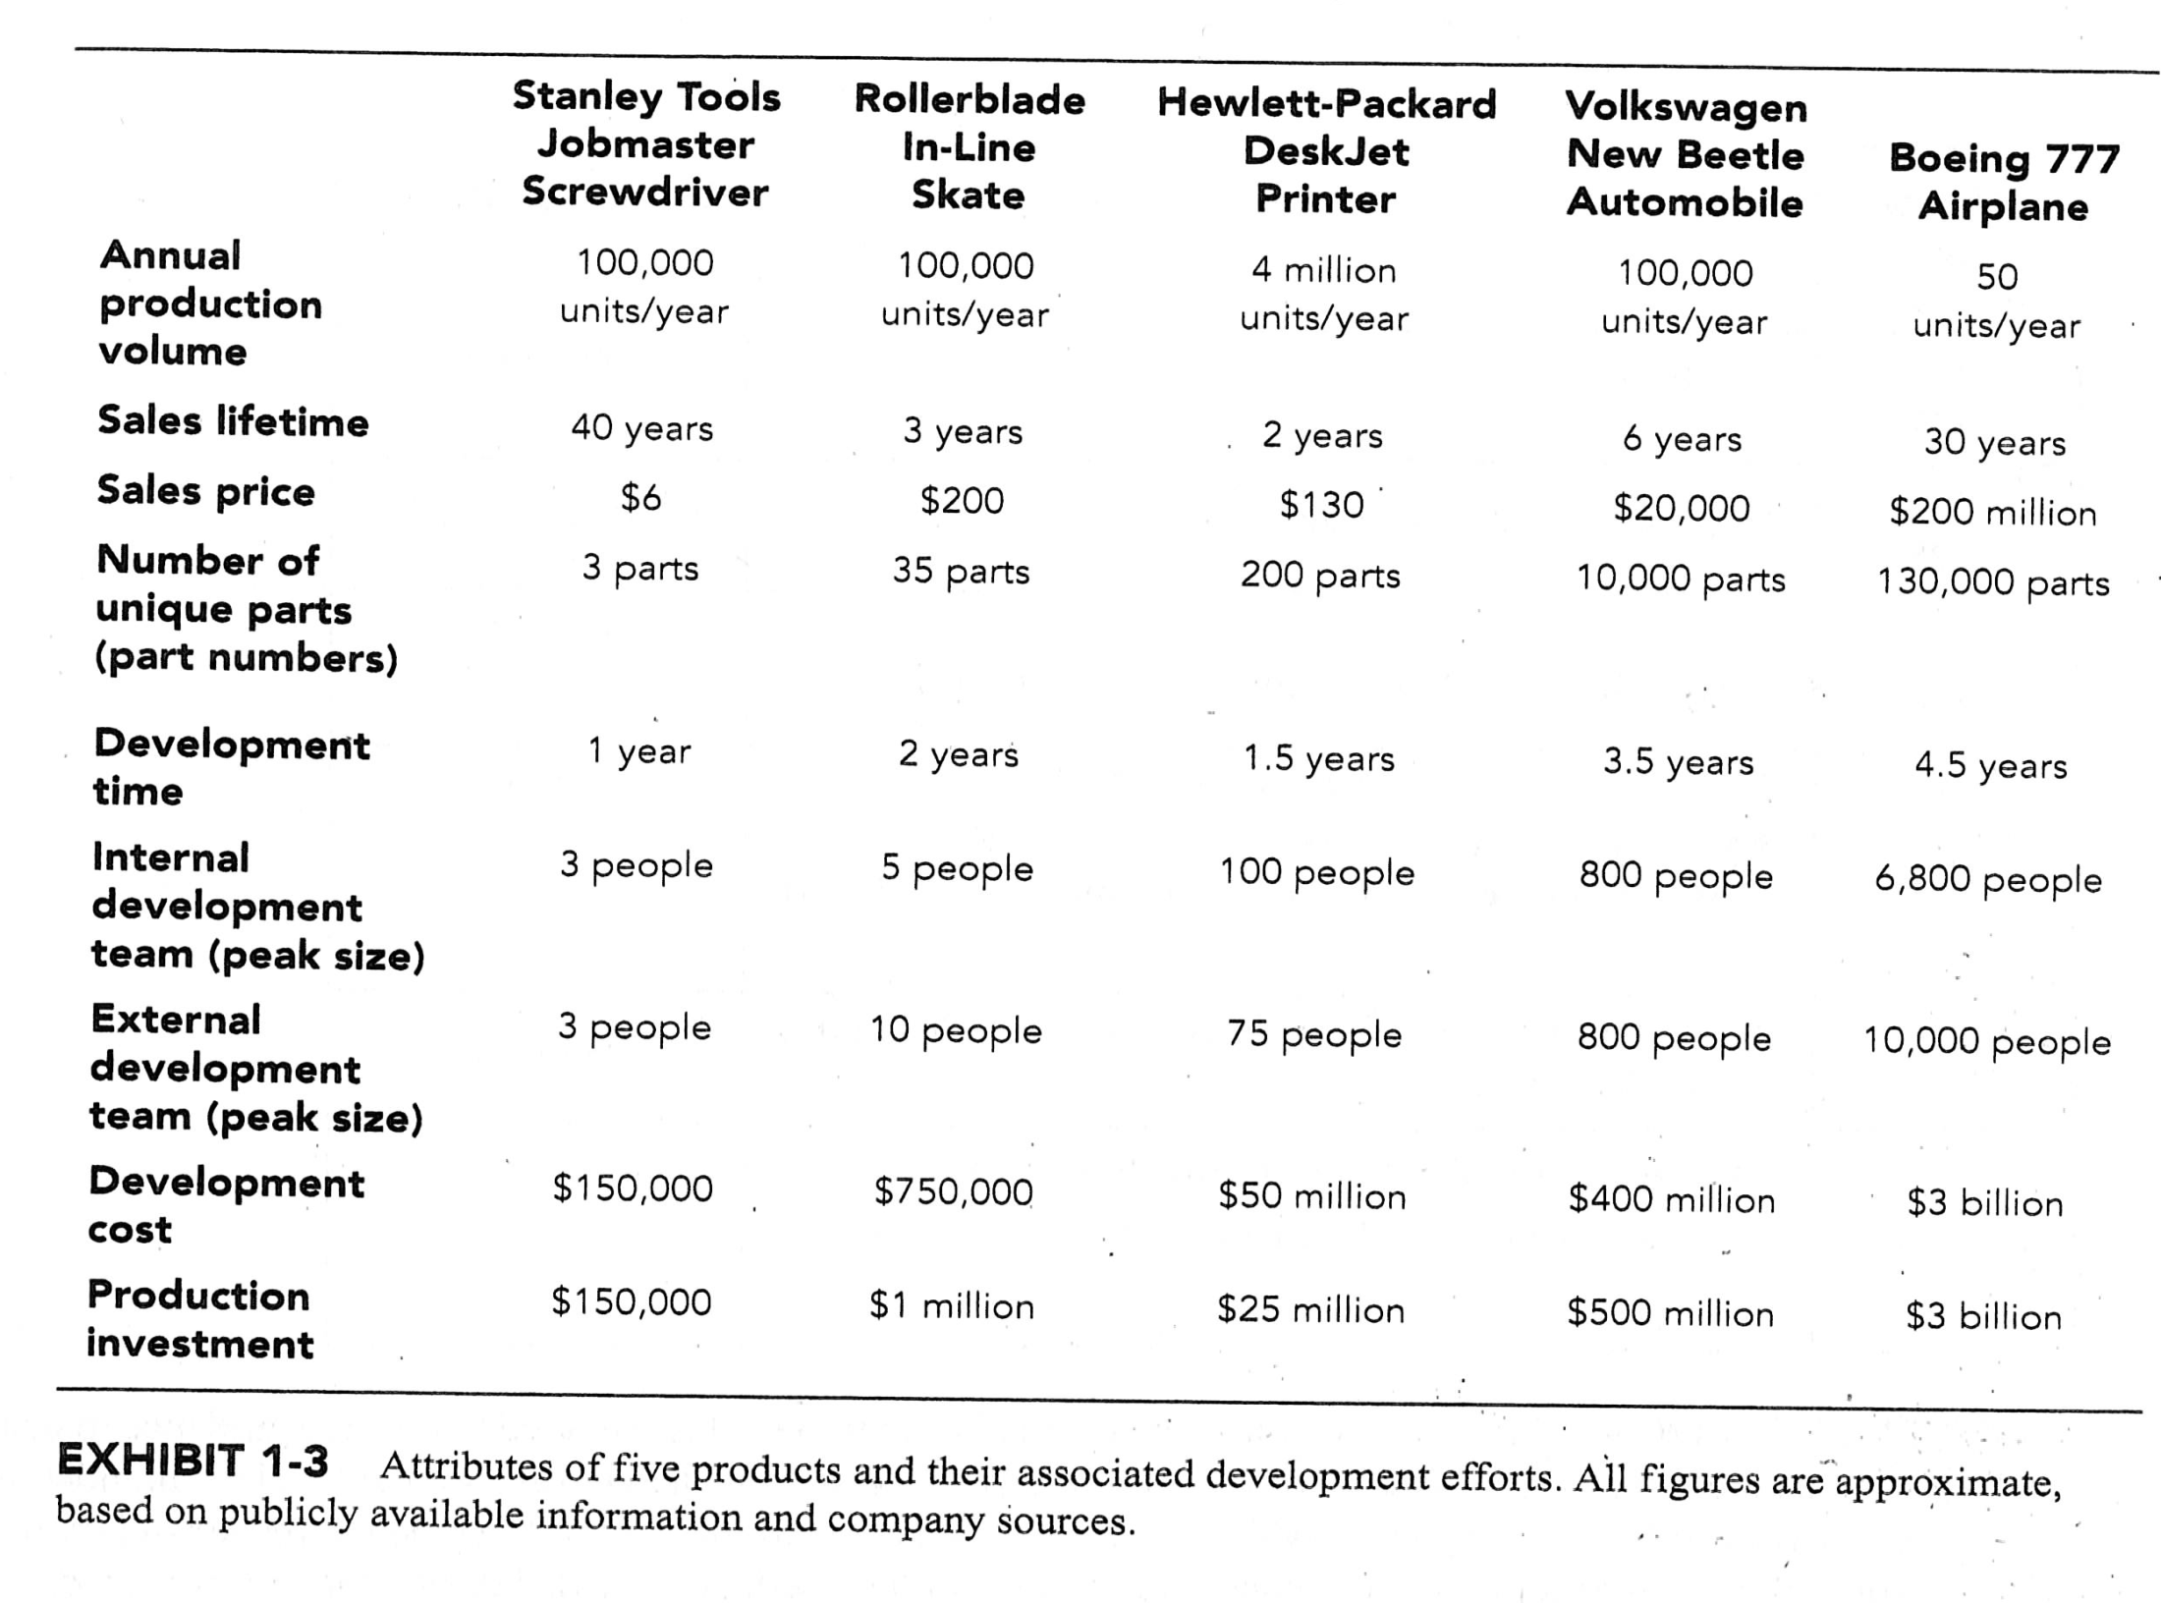

Slide 25
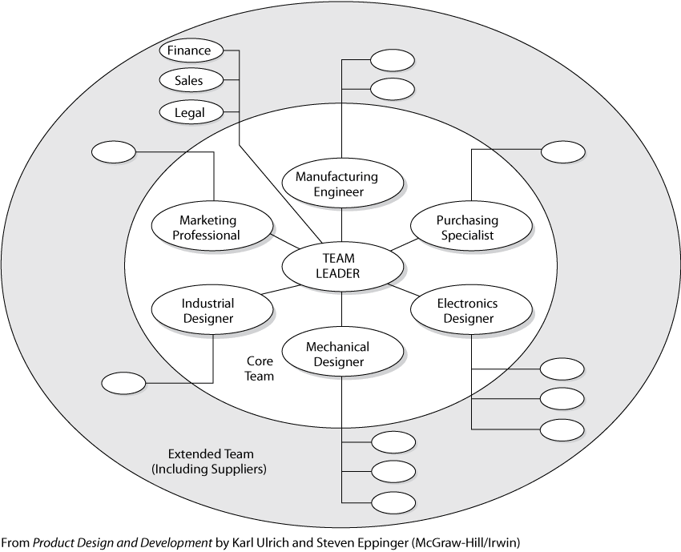

Slide 26
Product development team – core team
Marketing professional
Design professionals
  ME
  EE
  Industrial designer
Manufacturing professionals
  Manufacturing engineer (manufacturability)
  Purchasing specialist (supply chain)

Slide 27
Product development team – extended team
Legal, sales, finance professionals
Consulting firms
Government agencies
Universities
Environmental groups
Professional regulatory groups (such as the ASME)

Slide 28
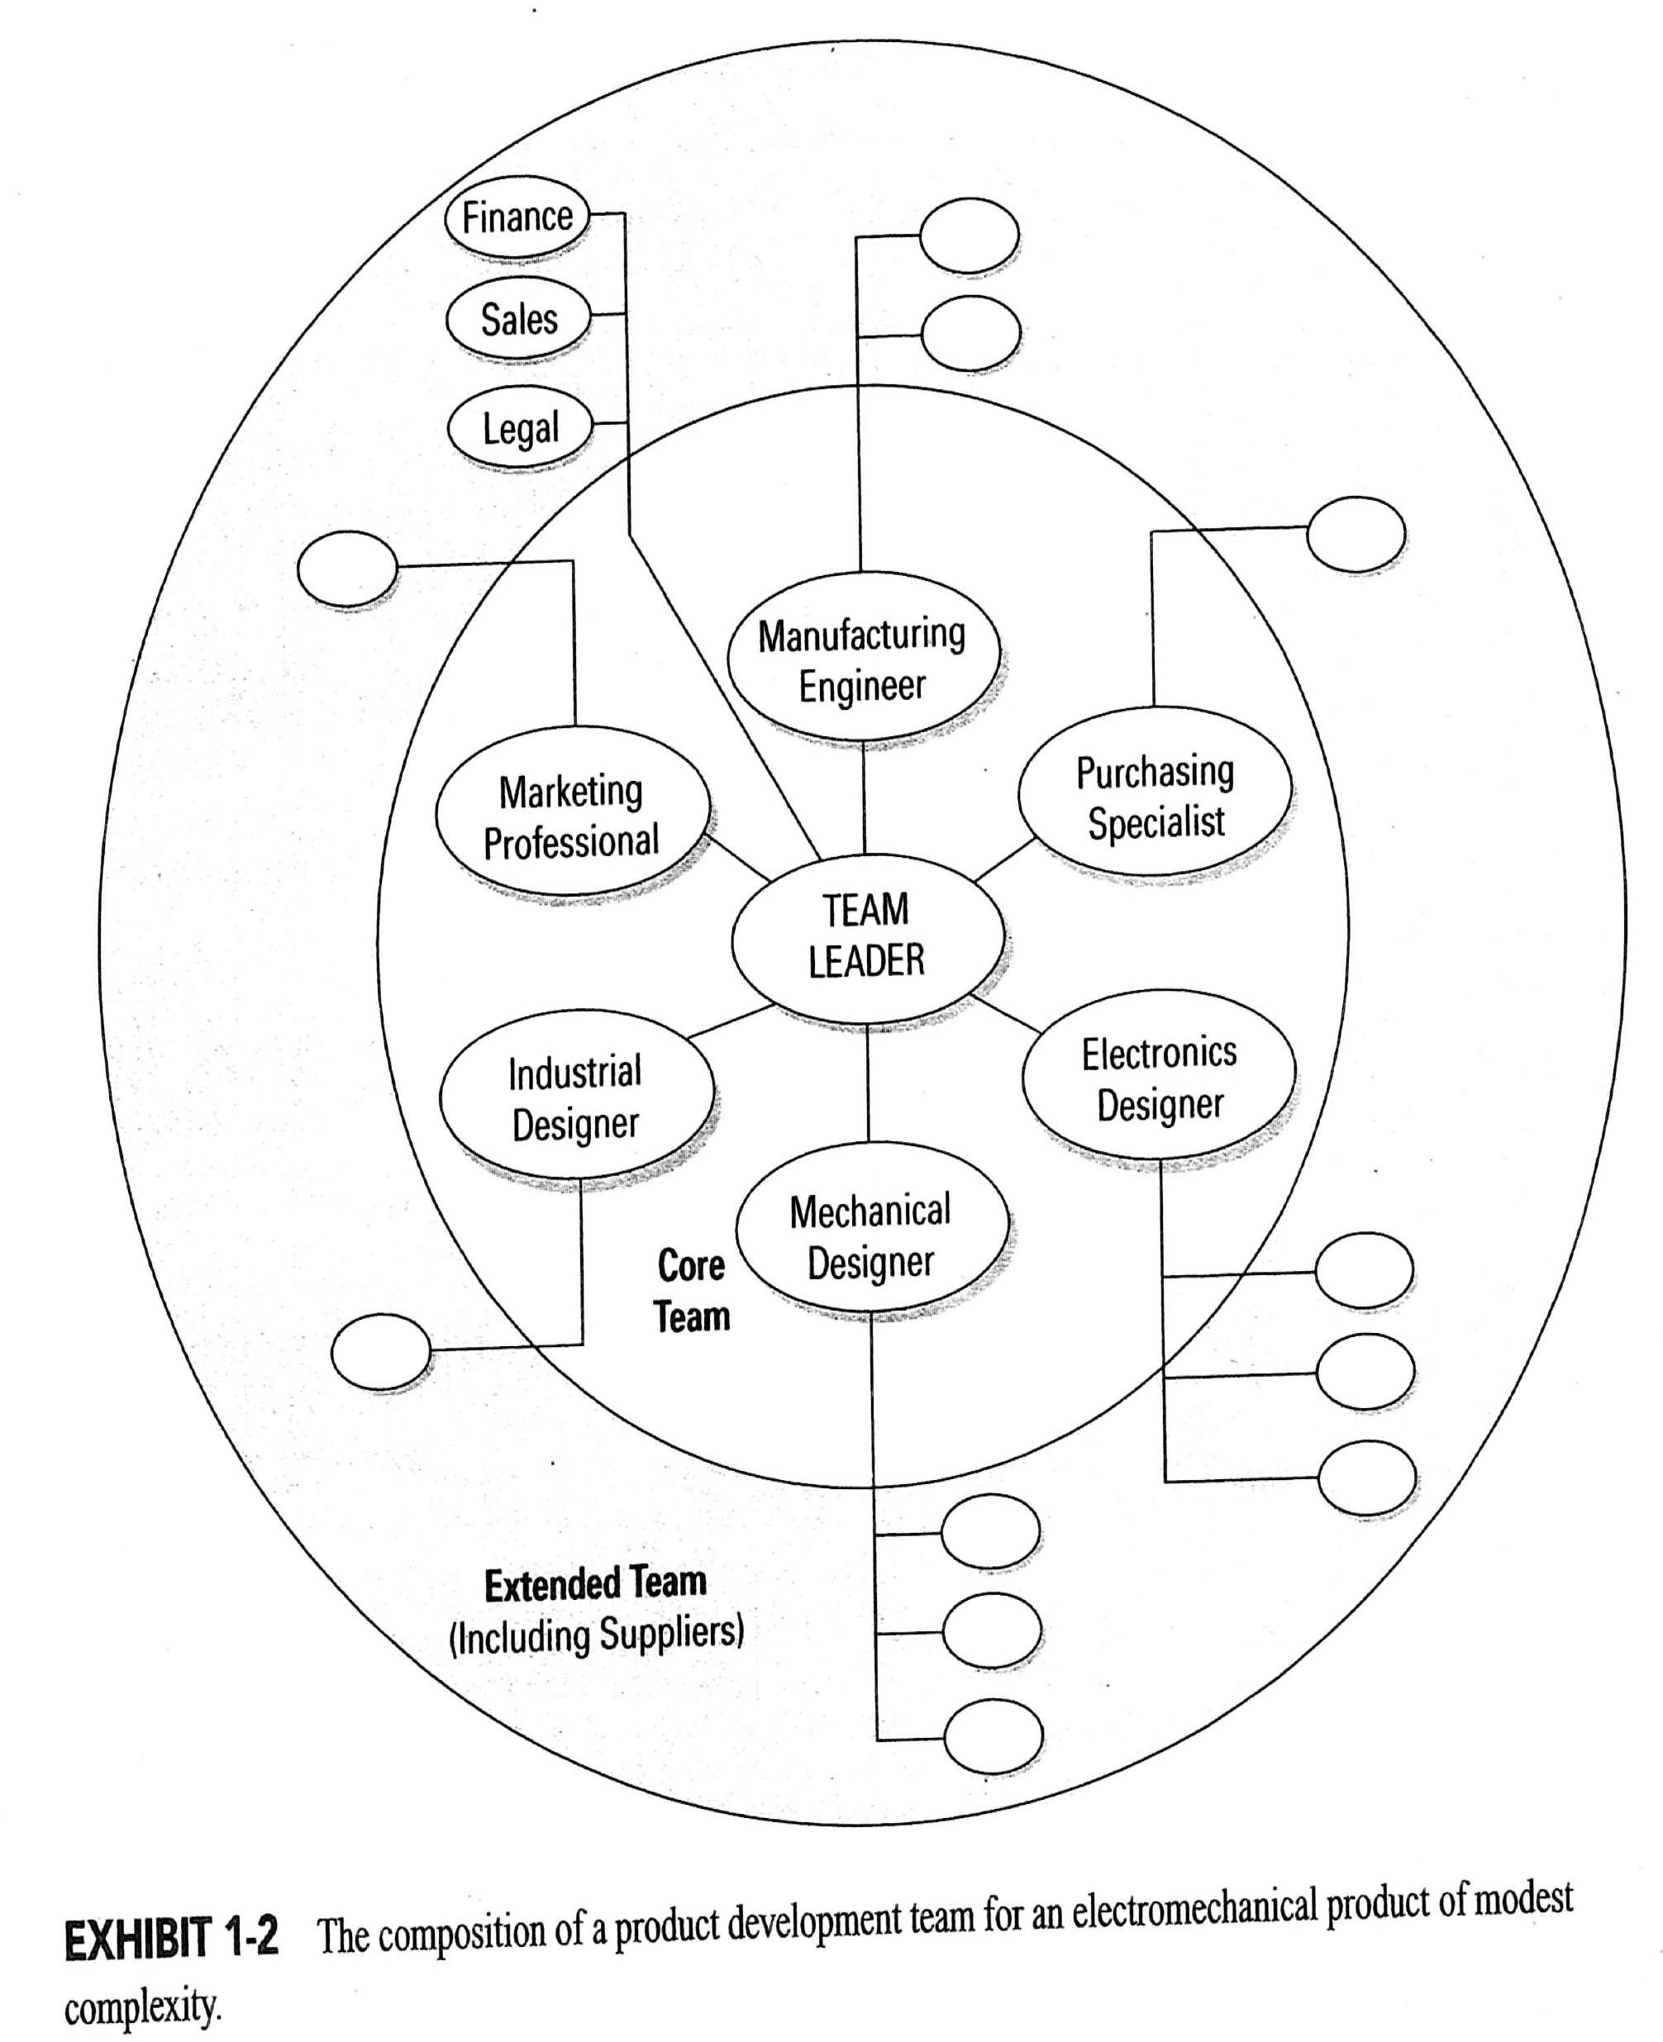

Slide 29
Benefits of integration
The best practice is to involve a team of people representing the necessary disciplines and skills (a cross-functional team)
Note:
  Assemble your project team of multi-disciplinary backgrounds as required.

Slide 30
Challenges of product development
Trade-off
Dynamics in the environment
Tremendous amount of design details
Time pressure
Satisfaction of societal and individual needs
Team diversity & spirit

Slide 31
Organizational realities
– leading to dysfunctional product development team
Lack of empowerment of the team
Functional allegiances transcending project goals
  That is, allegiance to functional department vs. project success
Inadequate resources
Lack of cross-functional representation on the project team

Slide 32
Structured methods
Product development process
  is a creative effort
  is a process of design-related activities, which can be documented, studied and improved.
Question?
  Is product development an art or an science?

Slide 33
Product development process
Major steps:
  Planning
  Concept development
  Architectural (system-level) design
  Detailed design
  Testing and refinement
  Production design and ramp-up
Also refer to ex. 2-2 on page 14 in chapter 2 for detail.

Slide 34
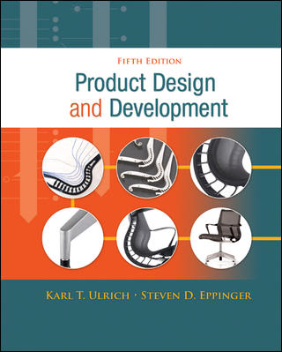
Product Design and Development
Karl T. Ulrich and Steven D. Eppinger
5th edition, Irwin McGraw-Hill, 2012.
Textbook
Introduction
Development Processes and Organizations
Opportunity Identification
Product Planning
Identifying Customer Needs
Product Specifications
Concept Generation
Concept Selection
Concept Testing
Product Architecture
Industrial Design
Design for Environment
Design for Manufacturing
Prototyping
Robust Design
Patents and Intellectual Property
Product Development Economics
Managing Projects

Slide 35
Chapter 1: HW assignment
Homework assignment
  Do exercise #2 on page 10
  Follow exhibit 1-3 to identify the scope of efforts for a PC (or cellphone) development project.
Due date: next week

